Slide 1
American Express Campus Analyze This 2016
Submission Deck – Iitrdsg Group,IIT Roorkee

Slide 2
Team Details
Team Name : iitrdsg
Name | Campus | Roll No. | Mobile No. | Email Id
Mihir Rana | IITR | 13117044 | 7060334131 | ranamihir@gmail.com
Nishant Raj | IITR | 14118062 | 7060334063 | nishant95.raj@gmail.com

Slide 3
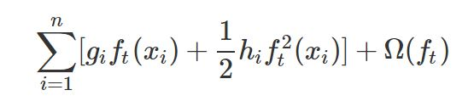
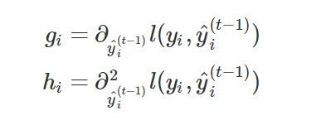
Equation to Identify Citizen’s Vote
Please provide the final equation used to identify the citizen’s vote
We used XGboost Regressor in our method
XGboost combines predictions of many weak classifiers to produce better outputs
Objective Function = Training Loss + Regularization
Additive training is used to train the trees
The objective function for tree number ‘t’ :
Here, h_{i} & g_{i} are :
Reference for model working : http://xgboost.readthedocs.io/en/latest/model.html

Slide 4
Details of each Variable used in the Equation
Please provide details of each variable used in the equation to identify citizen’s vote
‘home_ownership’ -> Home ownership indicator’
‘education_level_1’, ‘education_level_2’, … -> Education levels (label encoded).
‘prev_vote’, and ‘actual_vote’ were label encoded.
‘prev_residence_mean’, ‘prev_residence_std’, ‘curr_residence_mean’, and ‘curr_residence_std’ -> Means and Standard Deviations of ‘prev_vote’ were taken after grouping according to ‘prev_residence’ and ‘curr_residence’ respectively.
group_rally_centaur, group_rally_ebony, group_rally_odyssey, group_rally_cosmos, group_rally_toku -> # of group rallies for each party
Fundraiser_centaur, Fundraiser_ebony, fundraiser_toku , fundraiser_odyssey, fundraiser_cosmos, fundraiser_toku -> # of fundraisers attended for each party
Volunteer_centaur, volunteer_ebony, volunteer_toku, volunteer_odyssey, volunteer_cosmos -> # of times volunteered for each party
Variable hh_size was created for household size.
Variable age_bucket created and label encoded
Married -> Binary variable indicating marital status
newspaper -> # of newspapers, online sources, etc.
actual_vote -> Dependent variable

Slide 5
Estimation Technique Used
Please provide the estimation/modeling technique(s) used to arrive at the solution/equation
The name of each column was changed for convenience.
Missing values in ‘married’, ‘home_ownership’, and ‘education_level’ columns were replaced by the mode in the respective columns (since only 30 values were missing).
Dummy binary variables were created for ‘education_level’ and ‘age_bucket’.
‘prev_vote’, and ‘actual_vote’ were label encoded.
Means and Standard Deviations of ‘prev_vote’ were taken after grouping according to ‘prev_residence’ and ‘curr_residence’, and added as features.
A scoring function equal to that given in the problem statement was developed and maximised in cross validation to emulate leaderboard conditions.
An XGBoost Regressor was used as the learning model. The input features as stated before were fed to the model, and hyperparameter tuning was done using hyperopt, with the scoring function as negative of that given in the problem statement, and this was minimised. Once obtained, the model with optimal parameters was used to predict values on the test and final data set.

Slide 6
Reasons for Technique(s) Used
Why do you think this is the best technique(s) for this particular problem?
Previous Year Vote variable was dropped because it overpowered other variables by a very large extent and decreased the predictive power of the model. We tried ensembling by combining results with & without this variable but poor results were obtained.
Clustering the residence according to similar voting patterns, and hence reducing the cardinality from ~456 to much less could prove to be a useful feature. Training such a model will be much simpler, faster, and also more efficient.
Several models were tried, such as Random Forest, SVM, Neural Networks, GBM and XGBoost. Overall, boosting techniques were found to perform much better relative to others as they focus more efficiently on error reduction by giving more weights to the points where error has been made.

Slide 7
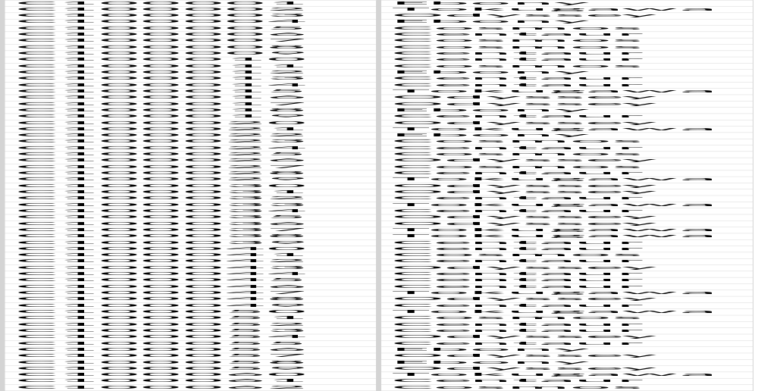
Final Submission File
Please embed your final submission file (.csv) here.

